Slide 1
Python
Input & Output
in programming

Slide 2
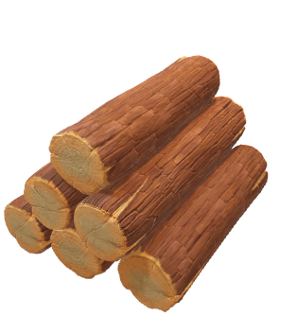
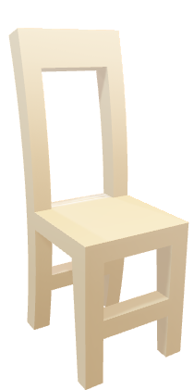
Input & Output in python
????
Diagrammatic representation
Process
Input
output

Slide 3
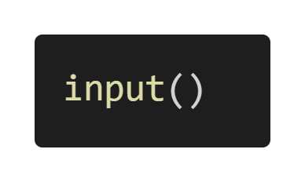
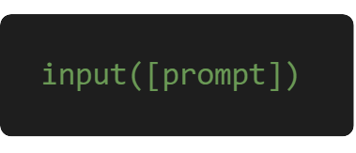
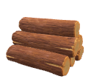
Input
Input
Developers often have a need to interact with users, either to get data or to provide some sort of result
The input() method reads a line from input, converts into a string and returns it
For taking basic input from user python has one simple function
The syntax of input( ) method is

Slide 4
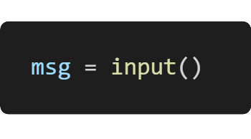
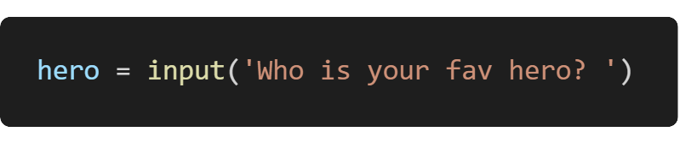

Input function working
Input
How input( ) works in Python?
Data stored
The input( ) function takes a single optional argument called prompt
The input() method reads a line from the input (usually from the user), converts the line into string and returns it.
A string that is written to standard output (usually screen) without trailing newline

Slide 5
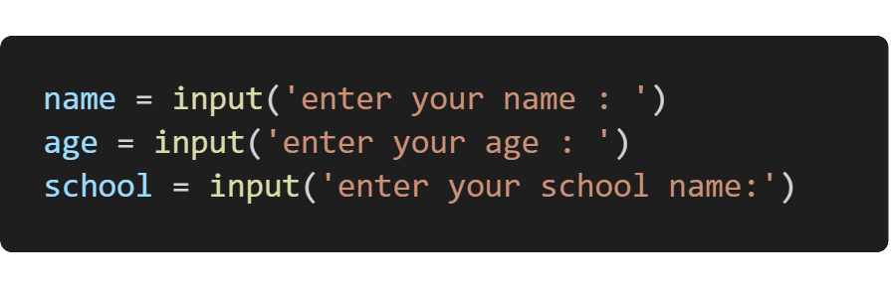
The datatype of user input
Input
Code
3 variables
The value returned from input( ) function is always string data type
name
age
school
All of string datatype

Slide 6
Try coding

Slide 7
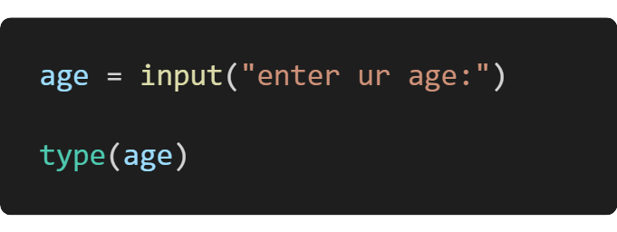

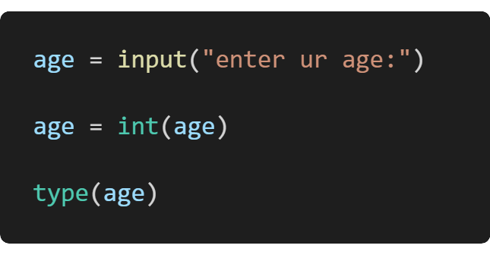

Casting in python
Input
str
Casting is when you convert a variable value from one type to another.
int

Slide 8
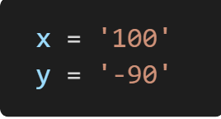
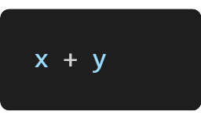

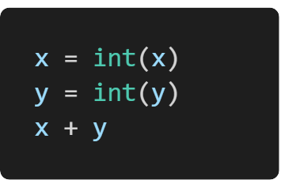
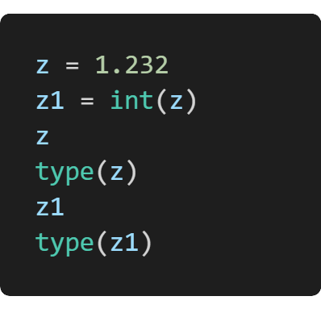
Casting in python
In python, its done with functions such as int() or float() or str().
Because string values don’t work like math
‘100-90’
10
1.232
float
1
Run all code lines in different cell for better understanding
int

Slide 9
Activity 1

Slide 10
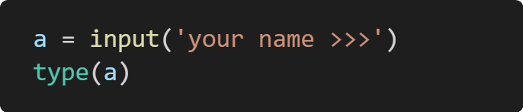
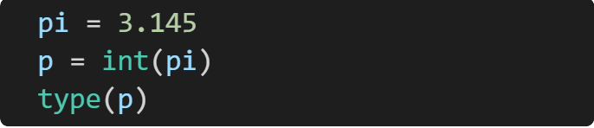

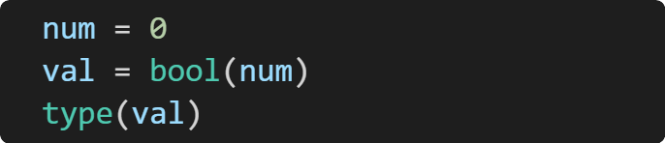
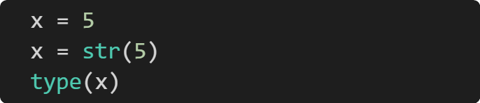
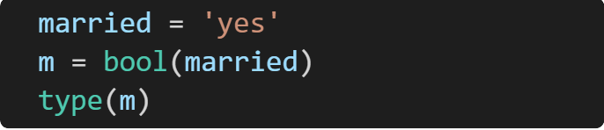
Write down the datatype given in code below ?

Slide 11
Input & Output in python
????
Diagrammatic representation
Process
Input
output
input() and print() are widely used for standard input and output operations respectively

Slide 12
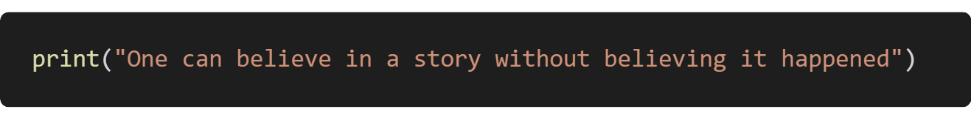
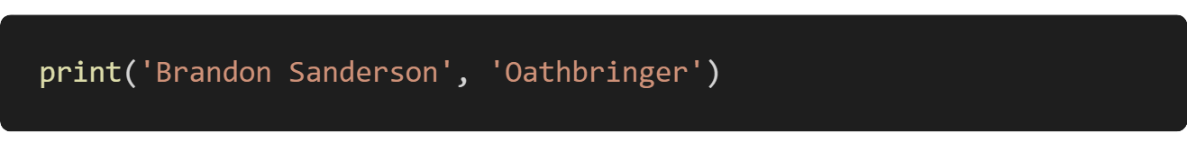

Output
output
print( ) function
We use the print() function to output data to the standard output device (screen)
Output formatting
you can pass zero or more expressions separated by commas
Output formatting is when you want to display the output making it more attractive and understandable
The syntax of print function is simple until you want to understand all options.

Slide 13
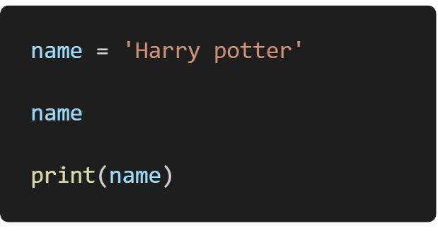
Print function
output
print( ) function
When you just put a variable in cell to see output, its known as raw output
When we display output using print( ) function its called formatted output
So, to understand the program ourselves we can use both but to display information correctly we have to use print() function
Passing data
As you can see, we can pass variable in print. Also we can mix other datatypes in one print( ) function
‘Harry potter’
Harry potter
Clean output

Slide 14
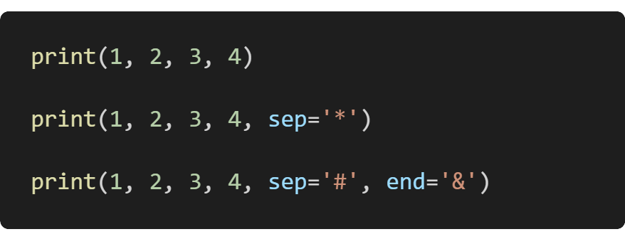
Formatting print
output
print( ) function
1 2 3 4
1*2*3*4
1#2#3#4&

Slide 15
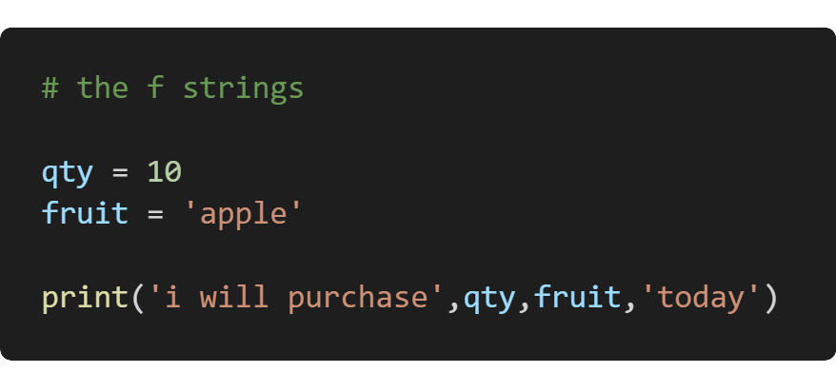

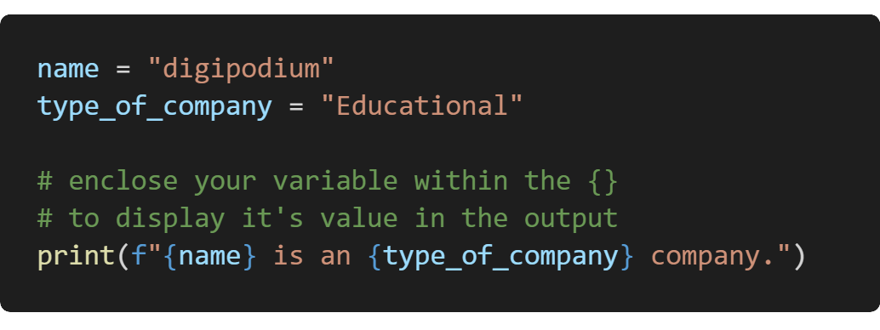
Formatting print
output
Output formatting
formatting?
Attractively designing your string using formatting techniques provided by the particular programming language.
We have different string formatting techniques in Python.
i will purchase 10 fruit today
the new f-string formatting technique, is the best way to format output. There are older techniques that we will discuss later
digipodium is an Educational company.

Slide 16
Try coding

Slide 17
THE END

